Slide 1
Class Diagrams
CS 3450
Introduction to Software Engineering

Slide 2
What is a Class Diagram?
Class diagrams help us visualize how to organize our code
They model how the program will be designed in the end
This helps us visualize flaws in our code… trust me
These diagrams are a great time to sit back, and re-think your design
You might find that your current plan is overly complicated
You might find that your current plan is unable to be coded
Class diagrams are somewhat difficult to get correct
There are a bunch of arrows to remember
This WILL be on a test, so practice now!
So, what’s in a Class Diagram?

Slide 3
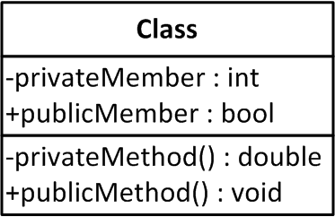
Class
This is how to represent a class
Name of class goes in first section
Members go in second section
Methods go in third section

Slide 4
Class
Members/Methods consist of 3 parts:
First
+ = public
- = private
# = protected
~ = package
/ = derived
underline = static
Second
Name of Member/Method
Third
Data/Return type

Slide 5
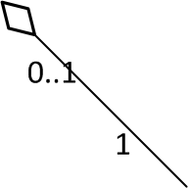
Aggregation
This is equivalent to a ‘has a’ relationship
Diamond is next to class that ‘has’ other class
For example:
A bike ‘has a’ streamer
A bike without a streamer is still a bike
Here, diamond would be next to ‘bike’

Slide 6

Composition
This is equivalent to an ‘owns a’ relationship
Diamond is next to class that owns other class
For example:
A bike ‘owns a’ chain
A bike cannot exist without a chain
Here, diamond would be next to ‘bike’

Slide 7

Inheritance
This is equivalent to an ‘is a’ relationship
Arrow points AT super class
For example:
A ‘Student’ is a ‘Person’
Here, arrow would point at ‘Person’

Slide 8
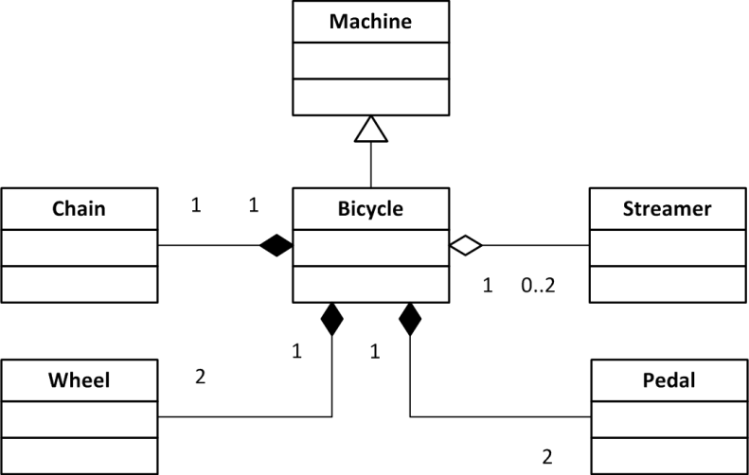
Full Class diagram

Slide 9
Remember
I didn’t add members/methods on my full class diagram. You need to.
Don’t mix up the arrows. They’re difficult to remember, but there are BIG differences between them
Try to model all of the classes that will be in your program

